Slide 1
Introduction
IN712 Web 3

Slide 2
IN712 Web Programming 3
Client-side development
HTML and CSS
JavaScript
DOM
Jquery
AJAX
User input validation
Events
React
Server-side development:
Node.js
Web sockets
Express framework
Deployment
Django Framework
MVC
Construction and consumption of REST APIs

Slide 3
Slack channel
Otago Polytechnic BIT slack channel
op-bit.slack.com
#web_programming_3
Make sure you check this channel regularly since it will be an official form of communication for the paper
If you do not join the channel, you will miss important announcements

Slide 4
Fetching Course content
Course content will be made available on I: drive or private GitHub
I:\COURSES\EAD\AITEIT3\BITY3\IN712-Web-3
If you want to use the GitHub repository for fetching course content, send me your GitHub username via personal message in Slack
Complete course directive on I: drive or private GitHub repo.

Slide 5
Course Calendar
Week | Date | Session 1 | Session 2
1 | 13/2/17 | Internet and HTML review | CSS layout review
2 | 20/2/17 | Advanced CSS | JavaScript 1 - Introduction
3 | 27/2/17 | JavaScript 2 - Objects | JavaScript 3 - regex and canvas
4 | 6/3/17 | JavaScript 4 - DOM, debugging | JavaScript 5 - events and HTML5 media
5 | 13/3/17 | JavaScript 6 - forms and validation | JavaScript 7 – JSON, local storage, advanced functions
6 | 20/3/17 | JavaScript 8 - AJAX | JavaScript 9 - jQuery
7 | 27/3/17 | Node.js 1 - Overview | Node.js 2 - buffers and streams
8 | 3/4/17 | Node.js 3 - advanced HTTP, Web sockets | Node.js 4 - advanced HTTP, Express framework
9 | 10/4/17 | Node.js 5 - advanced HTTP, deployment | JavaScript ES6, HTTP 2.0
Midterm Break
10 | 1/5/17 | Python | Django 1 – Intro
11 | 8/5/17 | Django 2 - views and templates | Django 3 - Dynamic content
12 | 15/5/17 | Django 4 - MVC, static files and template extending | Django 5 - Forms
13 | 22/5/17 | Django 6 - security and user generated content | APIs and web services
14 | 29/5/17 | REST APIs 1 | REST APIs 2
15 | 5/6/17 | React 1 | React 2
16 | 12/6/17 | React 3 | Presentations

Slide 6
IN712 2015
Note that there is not a big exam at the end
However, there will be theory work embedded in the practicals and projects
There will be many in-class practicals, which will not be specifically marked, but you need to do them so that you are prepared to tackle the assessments
Assessment | Weight
Javascript Client Side | 25%
Node.js | 25%
Server Side Django | 25%
REST APIs and React | 25%

Slide 7
Class Times and location
Tuesday 15:00-16:50
Thursday 10:00-11:50
D202

Slide 8
Announcement
I will not be able to be physically present on 3rd class of the paper (Tuesday, 21/2/27)
I will however update theoretical content, practical and video lecture to the I: drive and the GitHub repository

Slide 9
Preliminaries
The first 3 lectures this paper will be a sort of conceptual review of Internet concepts (HTML, CSS, Internet) to make sure we all are on the same page
Practical part of lecture is extremely important

Slide 10
Advise for a changing environment
Vast ecosystem of development stacks for web programming
We cannot cover them all
But we can cover some of the most important ones
The details and the tools keep changing
Know how to stay up to date
Become completely comfortable with change
Your position should be: “Give me a few days and a language manual and I can do it.”
When you become BIT graduates, you should know how to choose the right tool
You need to understand how to analyse a computation environment to determine what’s the most effective tool/ technique/ platform *for the application you are building today*

Slide 11
Web applications vs desktop applications
The user experience for a website is unlike the user experience for traditional desktop software
Limitations of data storage
Limitations of user interface
Limited access to operating system features
However, over time web applications have become more sophisticated
The differences in the user experience between desktop applications and web applications are becoming more and more blurred
Notes:
Advantages of web applications
Accessible from any Internet enabled computer
Usable with different operating systems and browser applications
Easier to roll out program updates since only software on the server needs to be updated and not on every desktop in the organization
Centralized storage on the server means fewer security concerns about local storage
Disadvantages of web applications
Requirement to have an active Internet connection
Security concerns about sensitive private data being transmitted over the Internet
Concerns over the storage, licensing, and use of uploaded data
Problems with certain websites on certain browsers not looking quite right
Restrictions on access to the operating system can prevent software and hardware from being installed or accessed
Adobe flash on iOS

Slide 12
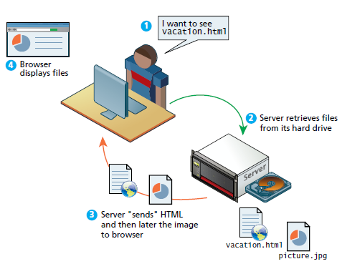
Static websites
Notes:
In the earliest days of the web, a webmaster would publish web pages and periodically update them. Users could read the pages but could not provide feedback. The early days of the web included many encyclopedic, collection style sites with lots of content to read
In those early days, the skills needed to create a website were pretty basic: one needed knowledge of the HTML and perhaps familiarity with editing and creating images. This type of website is commonly referred to as a static website, in that it consists only of HTML pages that look identical for all users at all times.

Slide 13
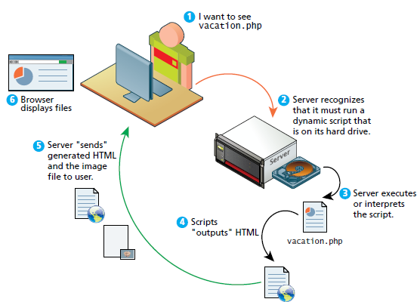
Dynamic websites
Notes:
Within a few years of the invention of the web, sites began to get more complicated as more and more sites began to use programs running on web servers to generate content dynamically. These server-based programs would read content from databases, interface with existing enterprise computer systems, communicate with financial institutions, and then output HTML that would be sent back to the users’ browsers. This type of website is called here in this text a dynamic website because the page content is being created at run time by a program created by a programmer; this page content can vary from user to user.

Slide 14
Web 2.0
For users, web 2.0 refers to an interactive experience where users can contribute and consume web content
For software developers, web 2.0 refers to a change in the paradigm of how dynamic websites are created
Programming logic, which previously existed only on the server, can also be migrated to the browser
Requires JavaScript
Techniques involved in asynchronous communication (AJAX)

Slide 15
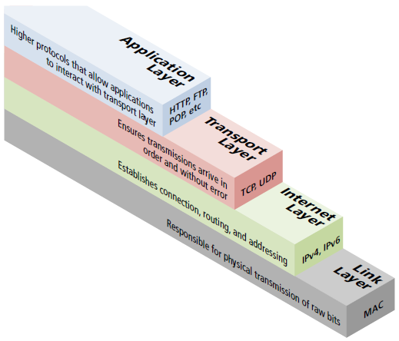
4 layer stack
Web protocols
Notes:
A protocol is a set of rules that partners use when they communicate
Protocols in digital communication take care of packet routing, transmission details, domain resolution, checksums and more
The TCP/IP Internet protocol was originally abstracted as a 4 layer stack
Layers communicate information up or down one level, but do not worry about layers far above or below
Lower layers handled the more fundamental aspects of transmitting signals through the network
Higher layers handle how clients and servers interact
In web development, we will focus on the highest layer, the application layer

Slide 16

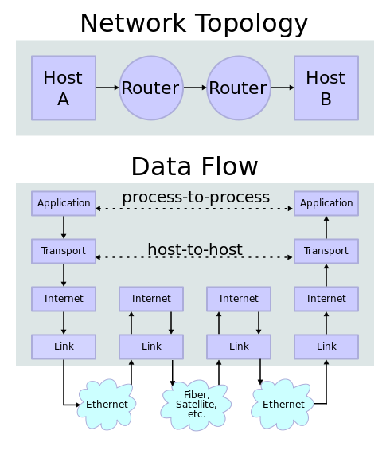
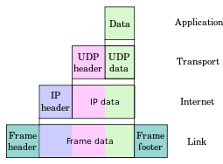
Data encapsulation
Notes:
As user data is processed through the protocol stack, each abstraction layer adds encapsulation information at the sending host. Encapsulation is removed by the receiving host. Intermediate relays update link encapsulation at each hop, and inspect the IP layer for routing purposes.
Link layer
Physical transmission across media ( wires, wireless)
Establishing logical links
Packet creation
Transmission
Reception
Error detection
Collisions
Line sharing
MAC (media access control) addresses: 48 or 64 bit identifiers assigned to network hardware

Slide 17
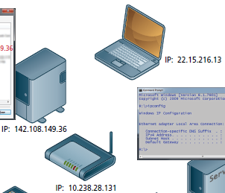
Internet layer (IP layer)
Roots packets between communication partners across networks
Provides “best effort” communication
It sends out the message to the destination, but expects no reply, and provides no warranty the message will arrive intact, or at all
Uses the Internet protocol (IP) addresses to identify destinations on the Internet

Slide 18
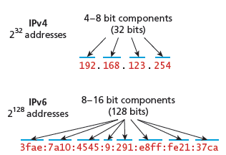
Internet layer (IP layer)
There are 2 types of IP addresses
IPv4
IPv6
In a local network, computers can share a single external IP address between them
For example, IP addresses in the range of 192.168.0.0 to 192.168.255

Slide 19
Transport layer
Ensures transmission arrive in order and without error
Data is broken into packets formatted according to the transmission control protocol (TCP)
Data in these packets can vary in size from 0 to 64K
Each data packet has a Header that includes a sequence number so the receiver can put the original message back in order, no matter when they arrive
Each packet is acknowledged back to the sender so in the event of a lost packet, the transmitter will realize a packet has been lost since no ACK arrived for the packet
That packet is retransmitted, although out of order and reordered at the destination
Sometimes we do not need warranted transmission of packets
Live multicast, voice over IP, online games…
User datagram protocol (UDP)

Slide 20
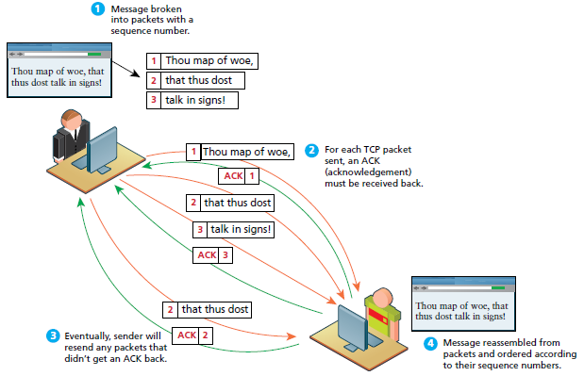
Transport layer (TCP packets)

Slide 21
Application layer
Protocols that should be familiar to most web developers
This protocols implement process to process communication
A few useful ones:
hypertext transfer protocol (HTTP): used for web communication
Secure shell protocol (SSH): allows remote command line connections to servers
File transfer protocol (FTP): used for transferring files between computers
POP/IMAP/SMTP: email related protocols for transferring and storing email
Domain name system (DNS): used for resolving domain names to IP addresses

Slide 22
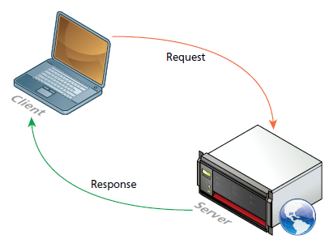
The client/server model (Request – response loop)
Notes:
The web is often referred to as a client/server model of communication
The server is a computer agent that is normally active 24/7 listening for queries from any client who make a request
The server has web applications, stores user and program data and perform security authorization tasks
The server listens for requests and upon getting one, responds with a message
A client is a computer agent that makes requests and receives responses from the server in the form of response codes, images, text files and other data
The clients make requests to particular servers for particular resources using URLs and then wait for the response

Slide 23
Web servers
A computer that responds to HTTP requests
Use additional software to make them more reliable and replaceable
To run a Web server and application stack to run a website has to be chosen. This includes:
Operating system
Web server software
Database
Scripting language
LAMP software stack: Linux, Apache Web server, MySQL database, PHP scripting language
WAMP
OSX MAMP
WISA: Windows, IIS Web server, SQL server database and the ASP.net server side development technologies
Server-side scripting software that responds to HTTP requests
PHP
Python (Django, Flask,…)
Ruby (Ruby on rails)
node.js
ASP.NET
Java

Slide 24
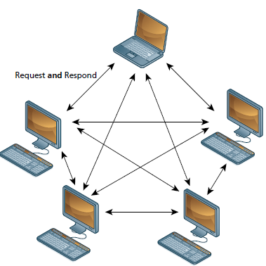
The Peer-to-Peer Alternative
Notes:
It may help your understanding to contrast the client-server model with a different network topology. In the peer-to-peer model each computer is functionally identical, each node is able to send and receive data
directly with one another.
In such a model, each peer acts as both a client and server, able to upload and download information. Neither is required to be connected 24/7, and with each computer being functionally equal, there is less distinction between peers.
The client-server model, in contrast, defines clear and distinct roles for the server. Video chat and bit torrent protocols are examples of the peer-to-peer model.

Slide 25
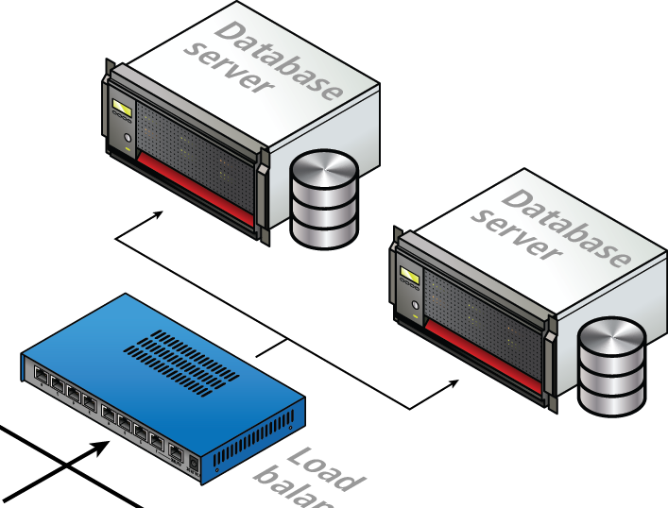
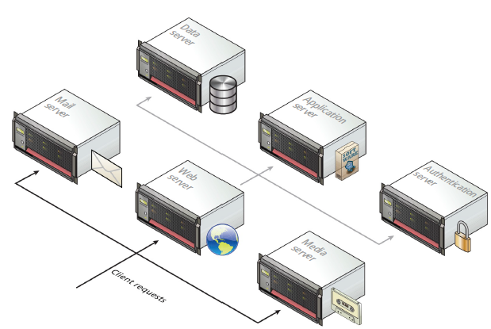
Server types

Slide 26
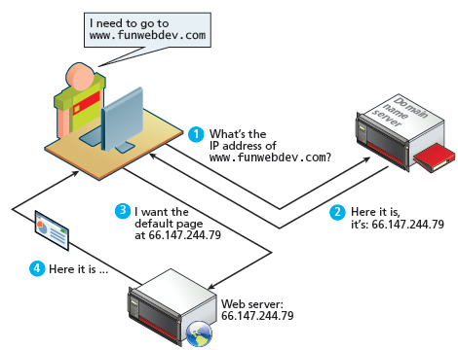
Domain name system
Separates the domain name of the server from its IP location

Slide 27
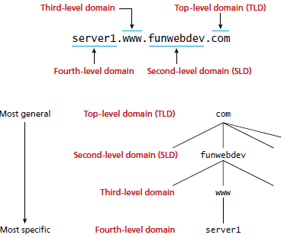
Name levels
A domain name can be broken down into several parts
They represent a hierarchy
The rightmost parts being closest to the root at the top of the Internet naming hierarchy

Slide 28

Uniform resource locators (URL)
It consists of two required components:
the protocol used to connect
the domain (or IP address) to connect to
An optional components:
Port:
Path
Query string
fragment

Slide 29
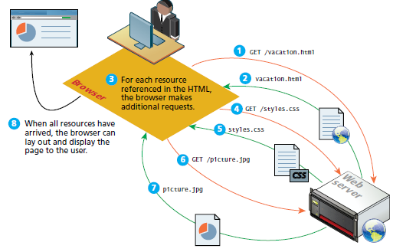
Hypertext transfer protocol
The HTTP establishes a TCP connection on port 80 by default
The server waits for the request and then response with a response code, feathers and an optional message ( which can include files)
Visiting a webpage is facilitated by the client’s browser
Request the initial HTML page
Parses the returned HTML to find all the resources referenced
Retrieves those resources

Slide 30
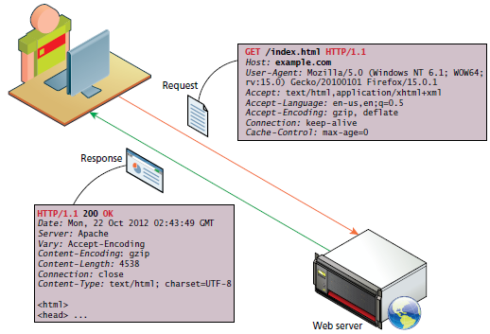
HTTP Methods, Headers and response codes
HTTP request methods
Path
Headers are sent in the request from the client
HTTP response codes
Headers are received in the response from the server
Headers encode the parameters for the HTTP transaction
Notes:
HTTP request headers include data about the client machine:
Host: allows multiple websites to be hosted of the same IP address
User – agent: informs what kind of operating system and browser the user is running
Accept: informs the server what kind of media types the client can receive in the response
Accept – encoding: informs the server what type of modifications can be done data before transmission ( the browser can specify if it can unzip compressed files)
Connection: specifies to the server whether it should keep the connection open or close it after response
Cache control: allows the client to control download of data according to certain constraints
HTTP response headers include data about the server machine:
Response codes
Server: tells the client about the server operating system and software
Last modified: information about when the requested resource last changed (this allows caching mechanism at the client)
Content length: specifies how large the response body will be (so the browser can then allocate an appropriate amount of memory to receive the data)
Content type: informs the browser what type of data is attached to the body of the message ( HTML, JPEG, PNG, XML…)
Content encoding: specifies to the client how the content was encoded so that it can be decompressed if need be

Slide 31
html
Web 3

Slide 32
Where did HTML come from?
HTML is a markup language
A way of annotating a document
Allow users to control the instructor of a document
Combining semantic markup with presentation markup is no longer permitted in HTML5
HTML5 is now a living language: that is, it is a language that evolves
Not all browsers and all versions support every feature of HTML5
You might detect problems moving from browser to browser
Acknowledge but ignore
We will use Chrome(latest installed version) for the course
I will be marking assignments in Chrome, so ensure your stuff looks correct in Chrome
4 reasons:
Market dominance, has sensible defaults, supports the majority of CSS3 and HTML5 features, has DevTools

Slide 33
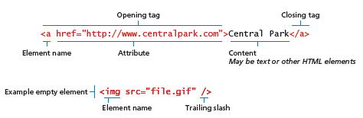
HTML syntax

Slide 34
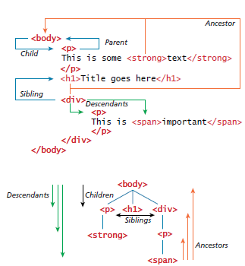
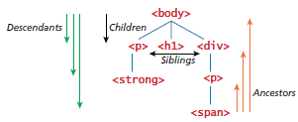
HTML document outline
This way of thinking will become useful when we learn how to use JavaScript to modify the DOM

Slide 35
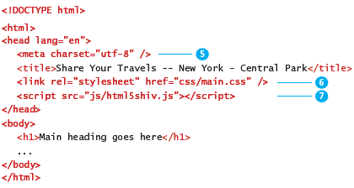
Structure of HTML documents

Slide 36
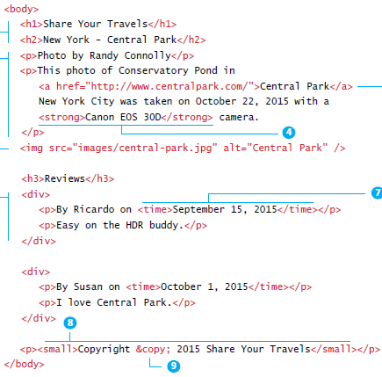
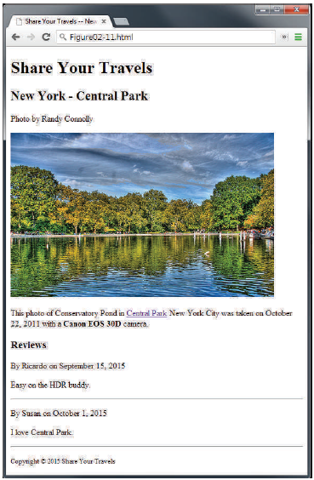
Headings paragraphs and divisions

Slide 37
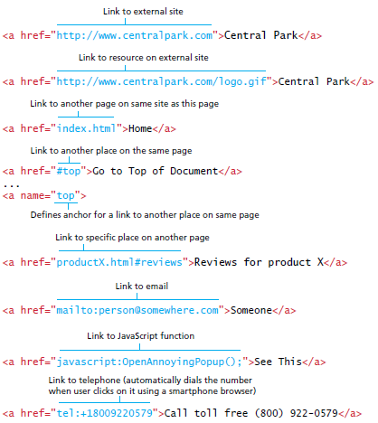
Anchor tags and URL Relative Referencing

Slide 38
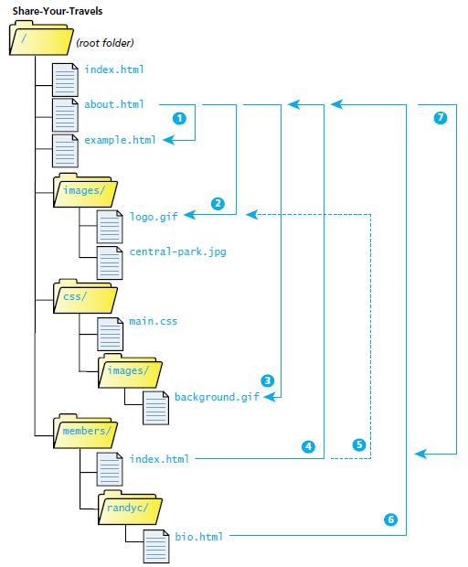
Site directory tree

Slide 39
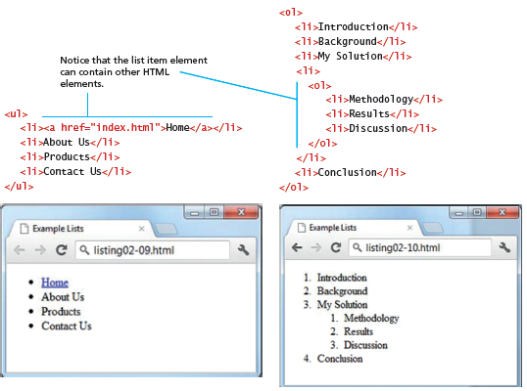
Lists

Slide 40
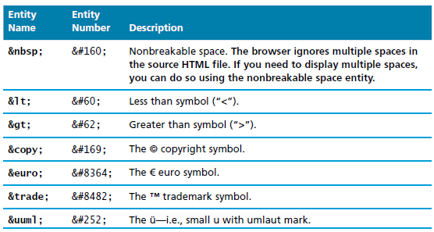
Character entities
Special characters for symbols for which there is no easy way to type them or for symbols which have a reserved meaning in HTML (“<“)

Slide 41

Semantic markup
HTML documents should not describe how to visually present content
Inline Styling is bad
Presentational tags are bad
HTML documents should describe its contents structural semantics or meaning
Eliminating presentation oriented markup and writing semantic HTML markup has several advantages:
Maintainability
Speed
Accessibility
Search engine optimization

Slide 42
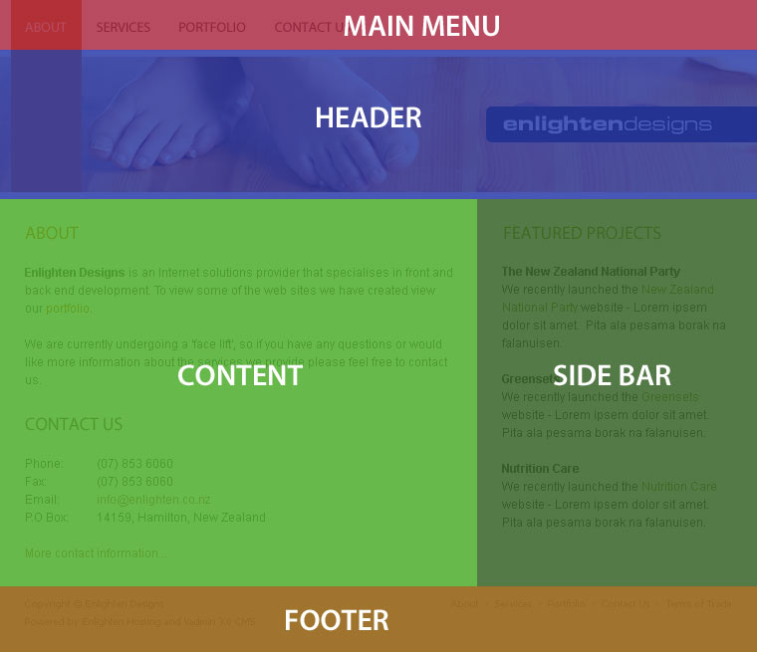
HTML5 semantic structure elements
Beyond <div>
Notes:
We all use div to separate our documents into chunks. Pragmatically, we do this so we can position them or apply CSS styles to them
But these chunks usually have distinct *semantic* roles – that’s why they are visually delineated by position or style
They are sections, or sidebars, or footers or whatever; these names are often reflected in the id’s that we give the divs
These semantic roles are important. Logically they express the semantic structure of the information on the page; pragmatically, web crawlers or TTS readers can use semantic information to better process and analyse the HTML

Slide 43
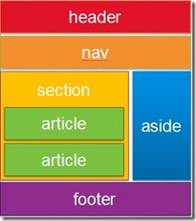
HTML5 semantic structure elements
Beyond <div>
Here are some of the new tags
Each defines a block element (i.e. it has padding, margin, etc. like a div does, available for styling)
Use these to describe the logical roles of the chunks in your document
You can still give them id’s if you need to for reaching them from the code behind
article
section
aside
figure
figcaption
header
footer
nav

Slide 44
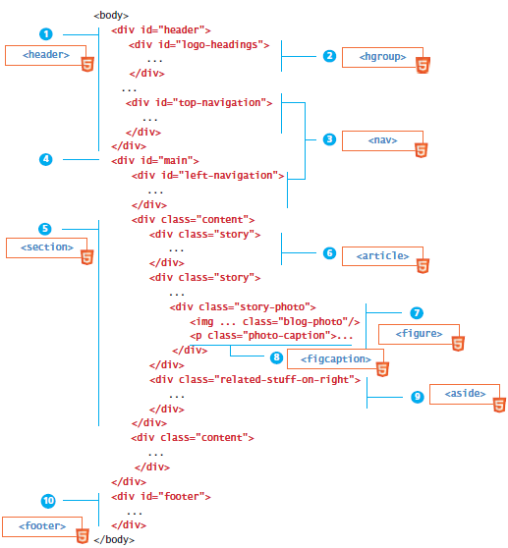
HTML5 semantic structure elements

Slide 45
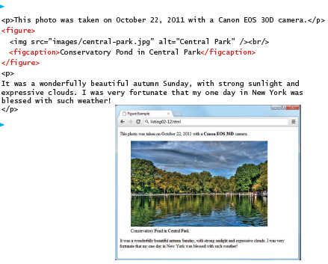
Figures and figure captions

Slide 46
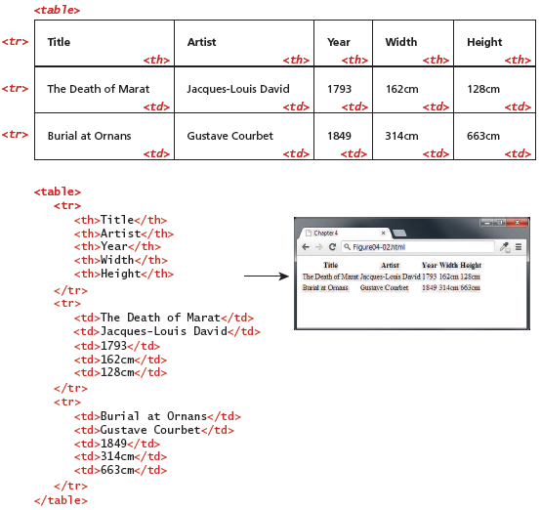
HTML tables

Slide 47
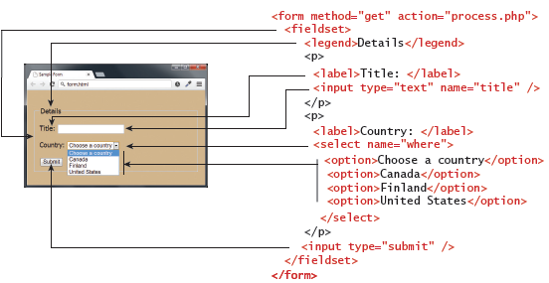
Forms

Slide 48
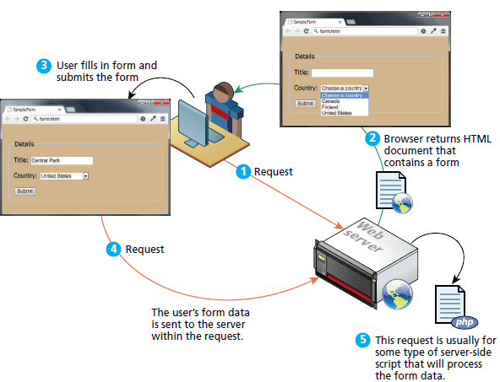
How forms work

Slide 49
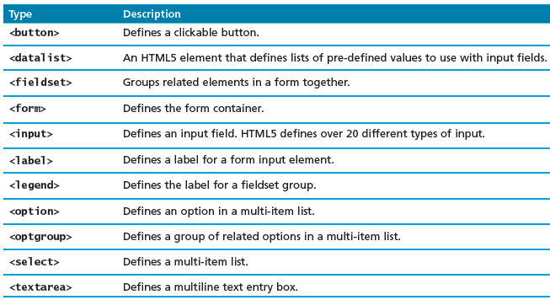
Form related HTML elements

Slide 50
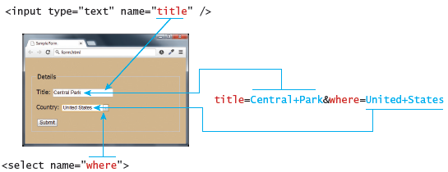
Query string data and its connection to the form elements

Slide 51
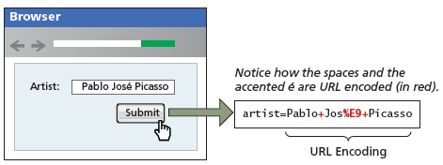
URL encoding

Slide 52
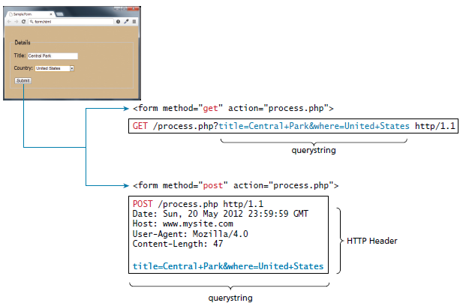
GET versus POST
Notes:
GET
Data can be clearly seen in the address bar. This could be:
An advantage during development
A disadvantage in production
Data remains in browsing history and cachet
Could be beneficial to some users
Could be a security risk on public computers
Data can be bookmarked
Limit on the number of characters in the form data returned
POST
Data can contain binary data
Data is hidden from user
Submitted data is not the stored in cache, history or bookmarks

Slide 53
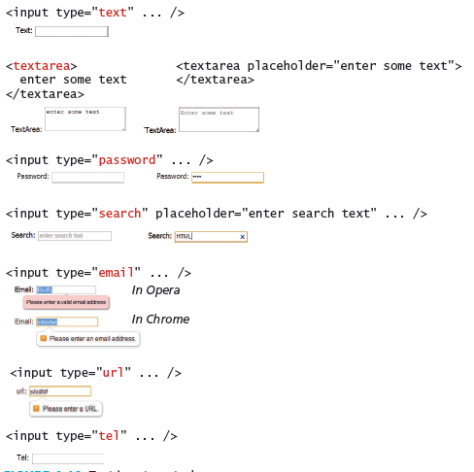
Text input controls

Slide 54
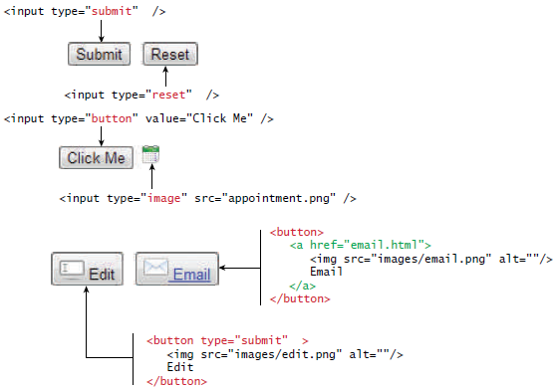
Button elements

Slide 55
Remember!
No physical class on Tuesday, 21/2/27
But you are responsible for covering the online class material
Practical part of lecture is extremely important

Slide 56
References
Fundamentals of Web Development

